Slide 1

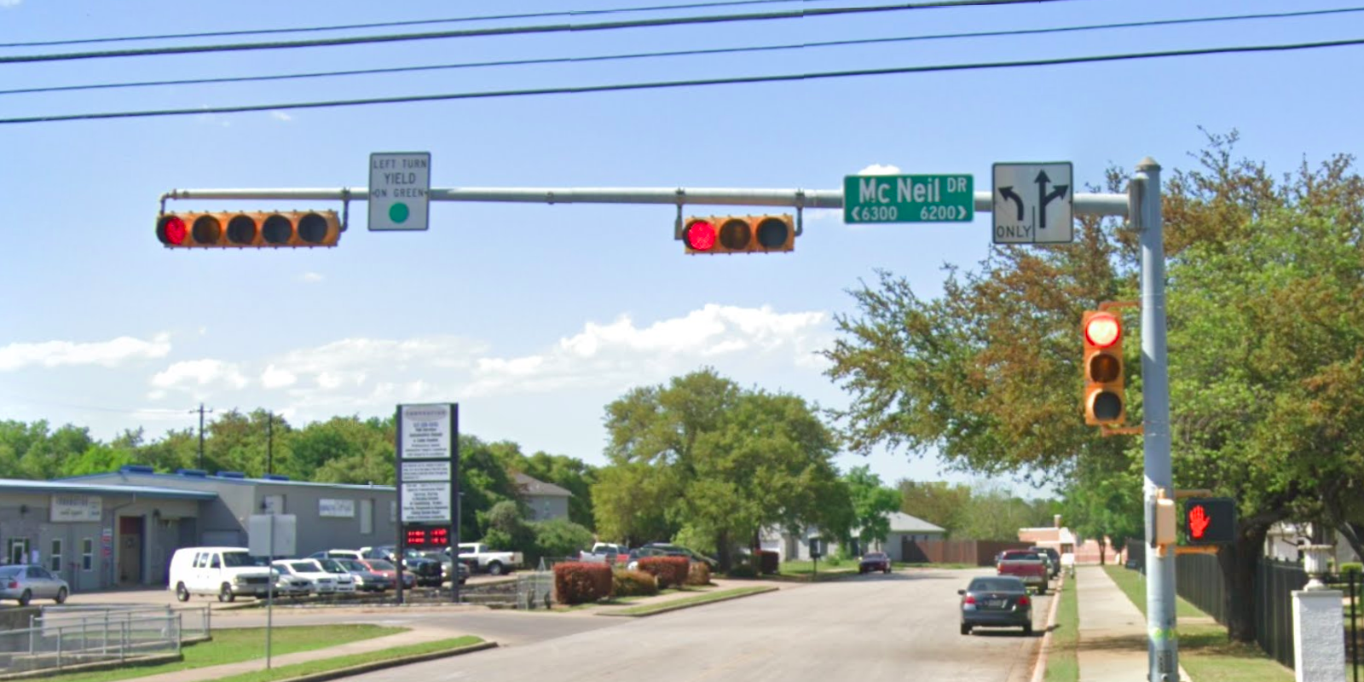
Austin Transportation Department Signs Work Orders
Created By: Susanne Gov Created Date: 2020-05-21 Location Name: MC NEIL DR / CORPUS CHRISTI DR Intersection ID: 5155299 Cardinal Direction: N
Sign Type | Install/Remove
Left Turn Yield On Green | Install
Street Name Sign | Install
Left Turn Arrow Only | Install
Straight Right Arrow | Install

Slide 2
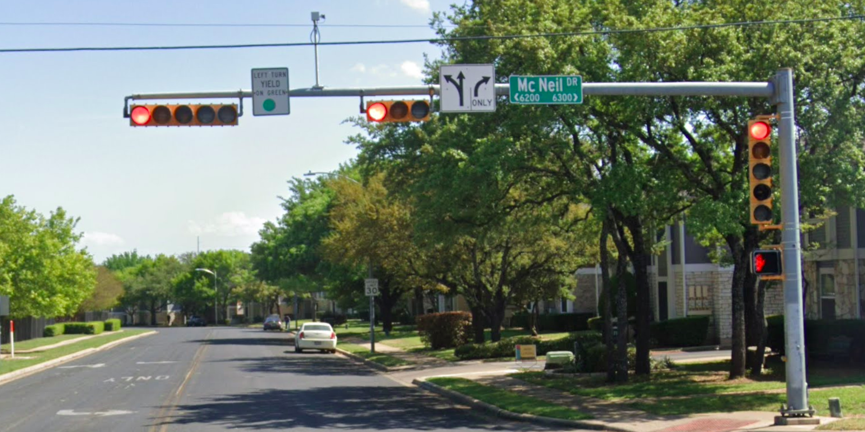
Austin Transportation Department Signs Work Orders
Created By: Susanne Gov Created Date: 2020-05-21 Location Name: MC NEIL DR / CORPUS CHRISTI DR Intersection ID: 5155299 Cardinal Direction: S
Sign Type | Install/Remove
Left Turn Yield On Green | Install
Street Name Sign | Install
Straight Right Arrow | Install
Right Arrow Only | Install

Slide 3
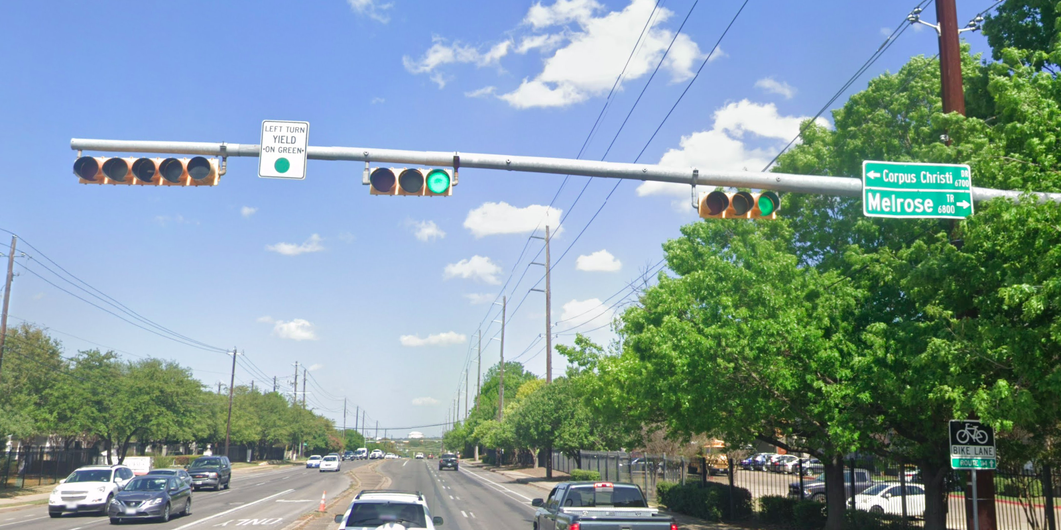
Austin Transportation Department Signs Work Orders
Created By: Susanne Gov Created Date: 2020-05-21 Location Name: MC NEIL DR / CORPUS CHRISTI DR Intersection ID: 5155299 Cardinal Direction: E
Sign Type | Install/Remove
Left Turn Yield On Green | Install
Street Name Sign | Install

Slide 4
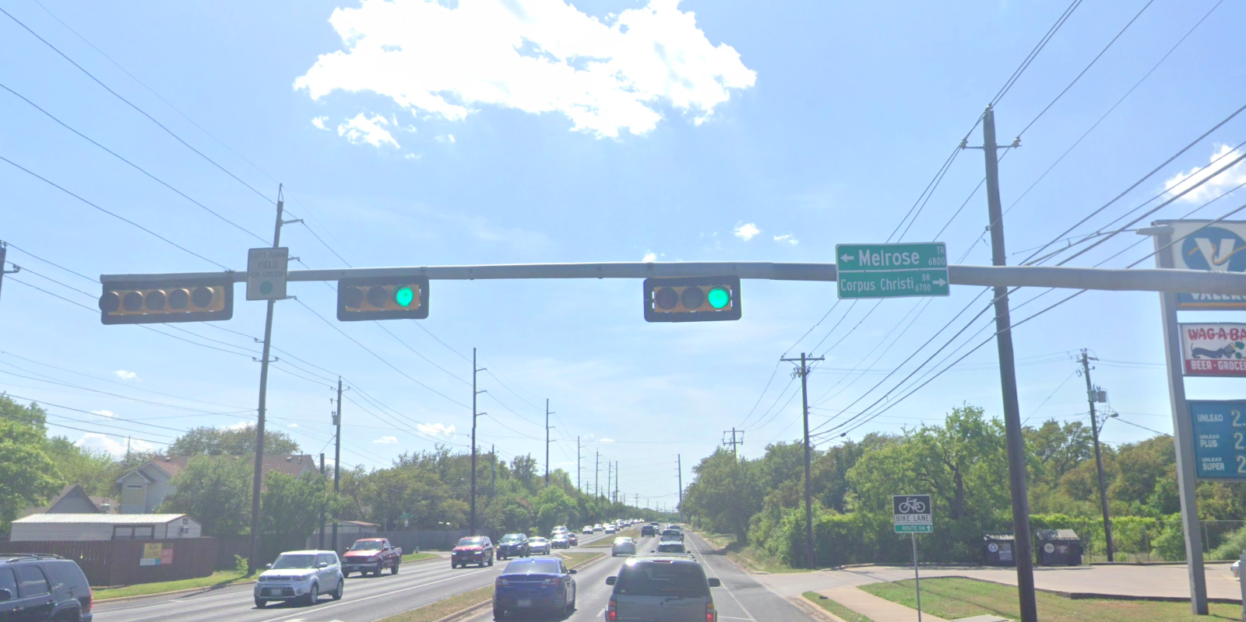
Austin Transportation Department Signs Work Orders
Created By: Susanne Gov Created Date: 2020-05-21 Location Name: MC NEIL DR / CORPUS CHRISTI DR Intersection ID: 5155299 Cardinal Direction: W
Sign Type | Install/Remove
Left Turn Yield On Green | Install
Street Name Sign | Install

